Slide 1
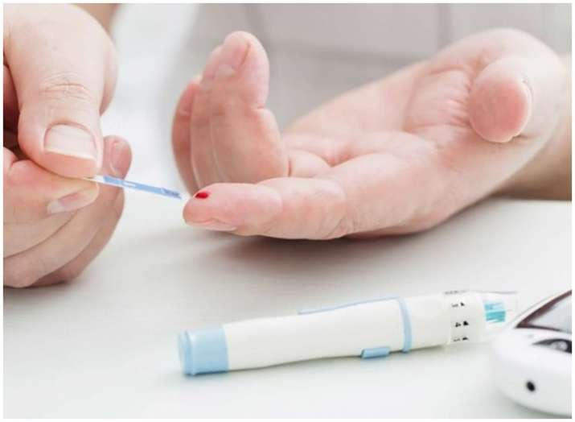

Slide 2
Prediction of Diabetes
Machine Learning

Slide 3
Introduction of Diabetes
Diabetes, a chronic metabolic disorder, is one of the fastest growing disease regardless of geographic, racial, or ethnic context. There are two types of diabetes:
Type 1
Type 2.

Slide 4
Types of Diabetes
- Type 1 diabetes happens when the pancreatic beta cells produce either very little insulin or no insulin.
- Type 2 diabetes happens when body become insulin resistance.

Slide 5
Symptoms and how to manage
The common symptoms for Type 1 diabetes are sudden weight loss, Dehydration, delayed healing, blurred vision and Type 2 have similar symptoms or no symptoms at all depends on body reaction. [1, 2]. Type 1 diabetes strikes both kids and adults at any age.There is no cure for Diabetes but it can be managed if it diagnose in early stage. Type 1 diabetes can be managed by medication and Type 2 can be managed by health diete, exercise and healthy lifestyle. In this project, we will be dealing exclusively with data about Type II diabetic patients.

Slide 6
Why we have chosen “prediction of Diabetes” as a topic
8.7% of males and 7.6% of females in Canada, equaling roughly three million individuals, had Type II diabetes in the year 2014 [4]. Nationally, in the year 2014, the incidence of new diabetes cases in the population was 5.9 out of every 1000 people [4]. Total health care costs resulting from diabetes in Canada is expected to increase to over $16.9 billion (CAD) annually by 2020. We would like to create a machine learning model that can correlationally predict whether or not an individual is at risk for Type II Diabetes based on a range of health features, in order to aid clinicians in preventing and treating the illness.

Slide 7
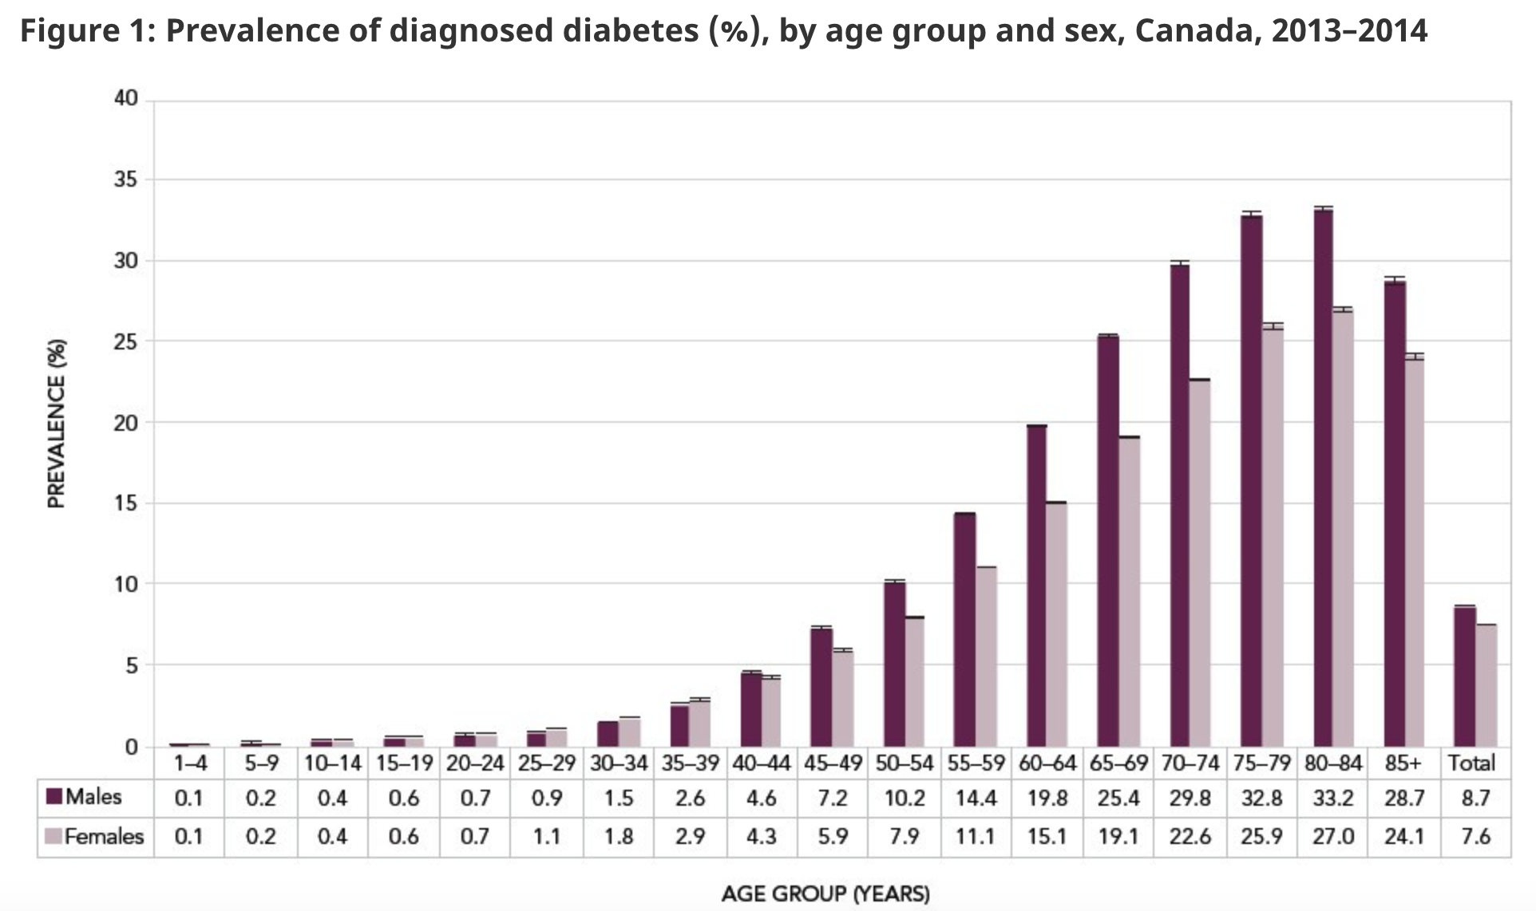
Diagnosed diabetes percentage

Slide 8
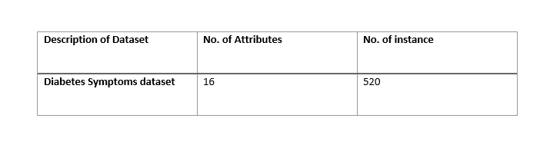
Description of Data
The dataset contains a record of 16 attributes about each of 520 patients, which may be correlated with their diabetic status, or "class". The data was collected from the patients in the Sylhet Diabetes Hospital of Sylhet, Bangladesh.

Slide 9
Question to consider
To what extent can a machine-learning model predict whether or not a patient is at risk of diabetes based on 16 different health and demographic attributes? Is such a model useful for classifying patients in a clinical setting so that preventative and if necessary, therapeutic measures may be implemented?

Slide 10
Extract, Transform and Load
The data set was downloaded as CSV file from University of California Irvine Machine Learning Repository
The CSV file was uploaded to AWS server S3 bucket for easy access
Using Pandas, read CSV into DataFrame
The diabetes dataset required minimum processing
The data need to transform into binary 0 and 1 for machine learning.
LabelEncoder module in Scikit library, which was used to convert data into 0 and 1
The gender column was filtered to divide into two datasets feale and male
The age column was further break down into 3 data frames that contained under 40, 40-60 and ober 60

Slide 11
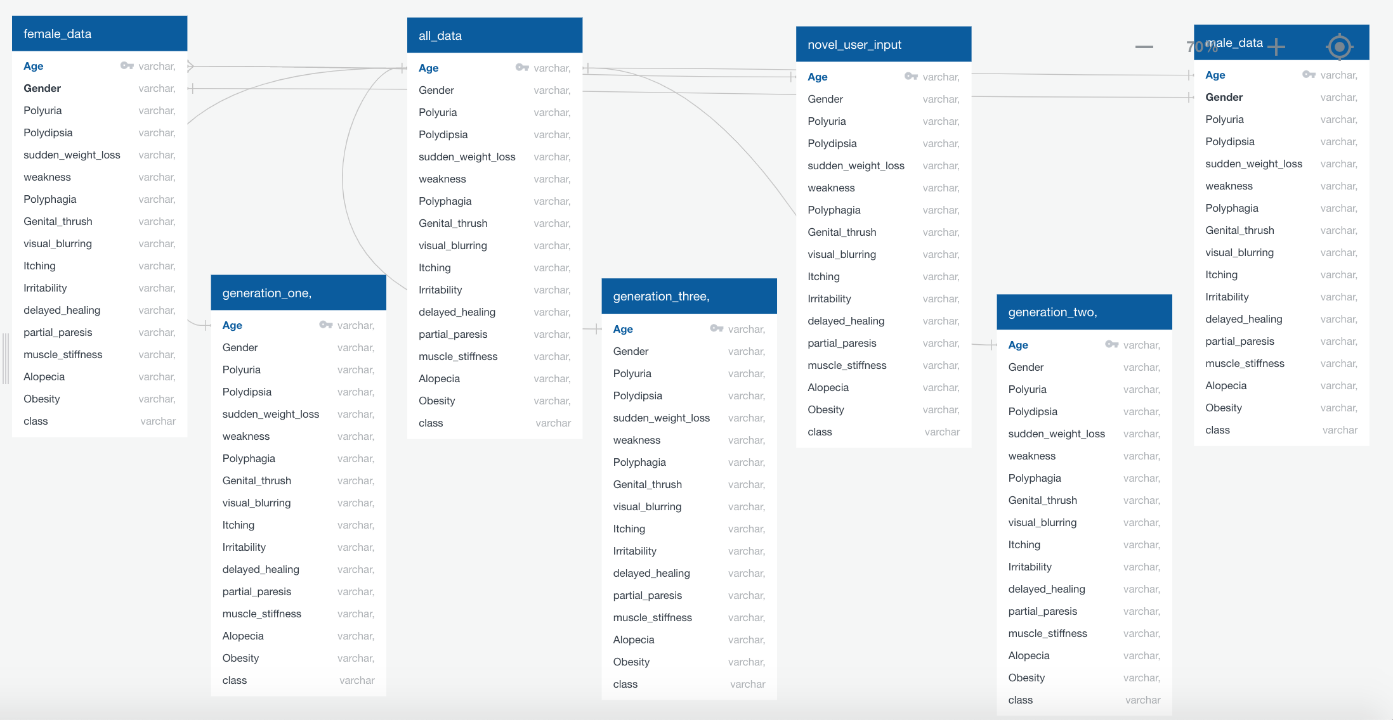
Database
The database is a rational database using PostgreSQL and hoted on AWS web services. The six data frames were loaded into PostgreSQL database.

Slide 12
Dashboard
The dashboard is a place to display the results of the analysis and to provide a place for the user to interact with the data. Since we are attempting to build an application that predicts instances of diabetes, the dashboard will provide the user with input fields to answer yes or no questions about the 16 different features. This data will be pushed to the database, where it can be accessed by the machine learning model. The machine learing model returns a prediction, based on the 16 factors, as to whether the individual is at risk or not at risk for diabetes. This is pushed back into the dashboard, where there are multiple graphs depicting where their data point stands in relation to all the other samples.

Slide 13
Tools
D3 JavaScript
HTML elements
Plotly
JavaScript

Slide 14
JavaScript
The JavaScript was used to create the script to connect the function for dropdown menu and bar chart.
- D3.json method used to read diabetess.JSON file
- Selector to create select function to add value into the interactive drop-down fields in index.html
- Function init () to initiate the dashboard
- Function buildCharts(age) to create the data for charts
- Plotly function to create analytical charts for diabetes dataset

Slide 15
HTML Elements
The HTML elements to create index.HTML file and the interactive fields
- <head> to show the heading on top
- <class=” row> used to create the rows in the web page
- <class=” col-md-8”> to size the columns to fit in page
- <class=” well”> used to create the drop-down menu
- <p> to add a paragraph about the Topic “Diabetes”
- <select> element to connect the function created in JavaScript.

Slide 16
References:
1. https://www.diabetes.ca/en-CA/about-diabetes
2. https://www.albertadiabetesfoundation.com/type-2-diabetes?gclid=CjwKCAiAqJn9BRB0EiwAJ1SztWQsJPkJ0cSmIA5_mo6FY-YJaOfQ3yL8lVYJY2vqKnNk5ba-Uz8mpRoC2YkQAvD_BwE
3. https://www.jdrf.ca/who-we-are/type-1-diabetes/
4. https://www.canada.ca/en/public-health/services/publications/diseases-conditions/diabetes-canada-highlights-chronic-disease-surveillance-system.html/

